Slide 1
Distributed Motion Coordination Using Convex Feasible Set Based Model Predictive Control
Hongyu Zhou¹ and Changliu Liu²
1. Work done during Hongyu’s internship at Intelligent Control Lab
2. Intelligent Control Lab, Robotics Institute, Carnegie Mellon University

Slide 2
Outline
Motivation
Contributions
Introduction to Convex Feasible Set Algorithm
Convex Feasible Set Based Distributed Model Predictive Control
Conclusions and Future Work

Slide 3
Outline
Motivation
Contributions
Introduction to Convex Feasible Set Algorithm
Convex Feasible Set Based Distributed Model Predictive Control
Conclusions and Future Work

Slide 4
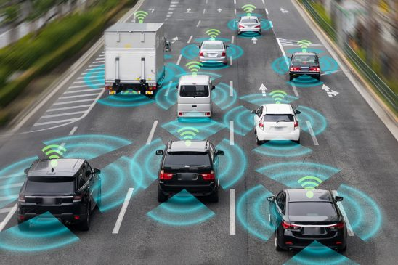
Motivation
Trajectory planning for connected autonomous vehicles remains challenging
Optimization-based methods can generate smoother trajectories and take into account the interaction among vehicles, but suffer from high computational complexity and potential deadlocks
Need to propose an efficient, safe, and coordinated multi-vehicle trajectory planning method

Slide 5
Outline
Motivation
Contributions
Introduction to Convex Feasible Set Algorithm
Convex Feasible Set Based Distributed Model Predictive Control
Conclusions and Future Work

Slide 6
Contributions
Extend convex feasible set (CFS) algorithm in a distributed fashion to solve multi-vehicle trajectory planning problem
Propose a deadlock resolution by changing vehicle’s desire speed
Simulate typical driving scenarios to validate our method

Slide 7
Outline
Motivation
Contributions
Introduction to Convex Feasible Set Algorithm
Convex Feasible Set Based Distributed Model Predictive Control
Conclusions and Future Work

Slide 8
Introduction to Convex Feasible Set Algorithm
An optimization algorithm for real time motion planning
Handle motion planning problems with convex objective functions and non-convex inequality constraints
Idea: obtain convex feasible sets within the non-convex inequality constraints
Solve the convex subproblems iteratively until solutions converge
C. Liu, C. Lin, and M. Tomizuka, "The convex feasible set algorithm for real time optimization in motion planning", in SIAM Journal on Control and Optimization, vol. 56, no. 4, pp. 2712-2733, Jul. 2018

Slide 9
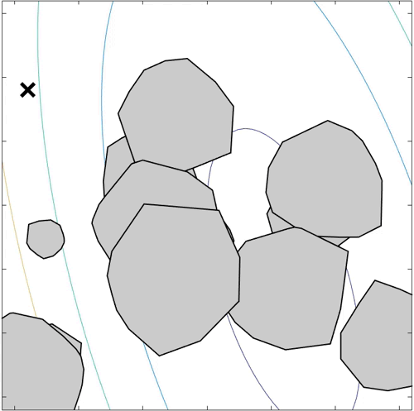
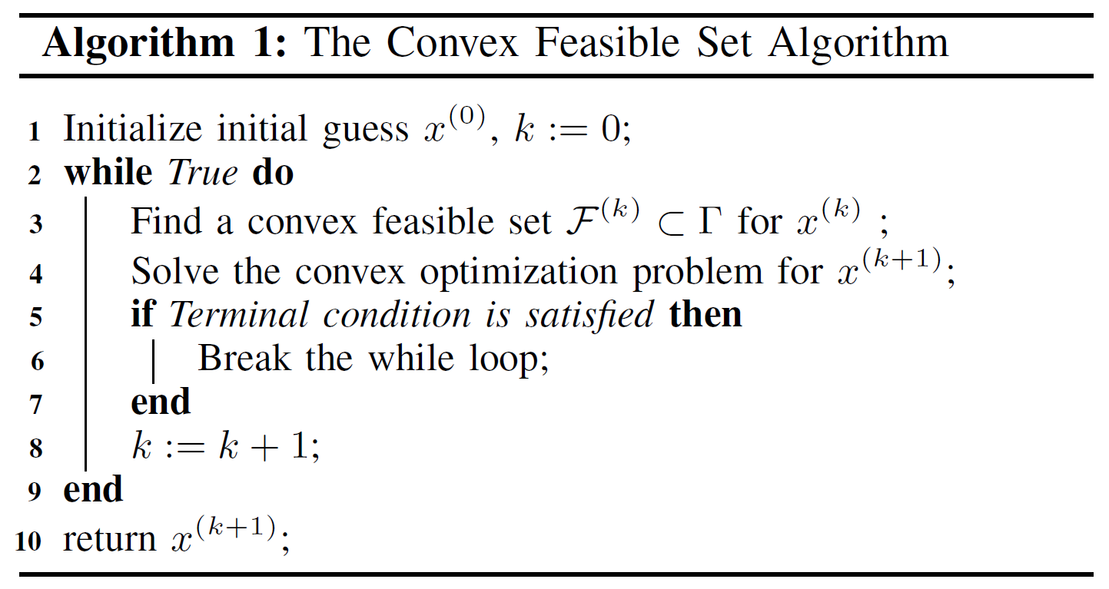
Pseudocode:
Introduction to Convex Feasible Set Algorithm
Courtesy of C. Liu
C. Liu, C. Lin, and M. Tomizuka, "The convex feasible set algorithm for real time optimization in motion planning", in SIAM Journal on Control and Optimization, vol. 56, no. 4, pp. 2712-2733, Jul. 2018

Slide 10
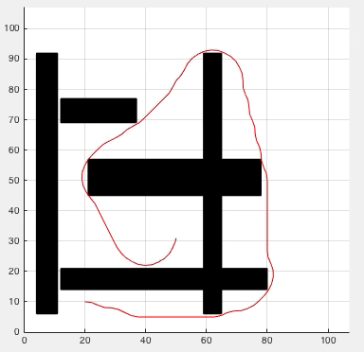
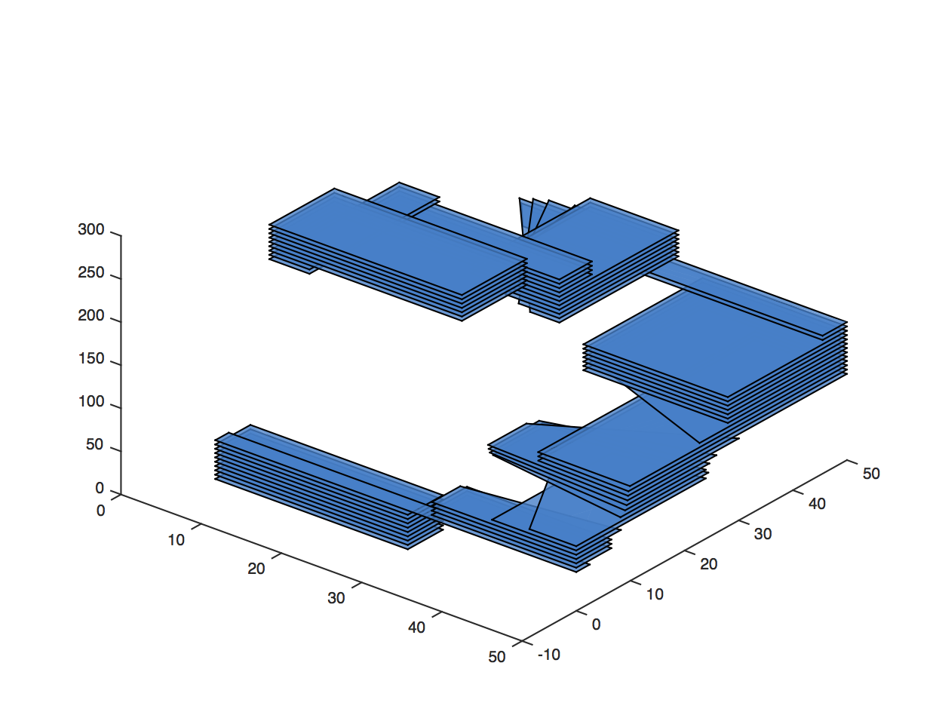
CFS for Efficient Long Term Planning
Introduction to Convex Feasible Set Algorithm
Stack the set of safe control (half spaces) for all time steps
Reduce the non-convex optimization problem to a convex problem
C. Liu, C. Lin, and M. Tomizuka, "The convex feasible set algorithm for real time optimization in motion planning", in SIAM Journal on Control and Optimization, vol. 56, no. 4, pp. 2712-2733, Jul. 2018

Slide 11
Outline
Motivation
Contributions
Introduction to Convex Feasible Set Algorithm
Convex Feasible Set Based Distributed Model Predictive Control
Conclusions and Future Work

Slide 12
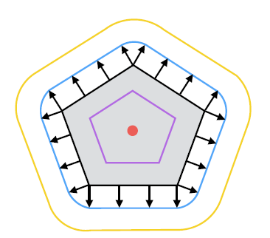
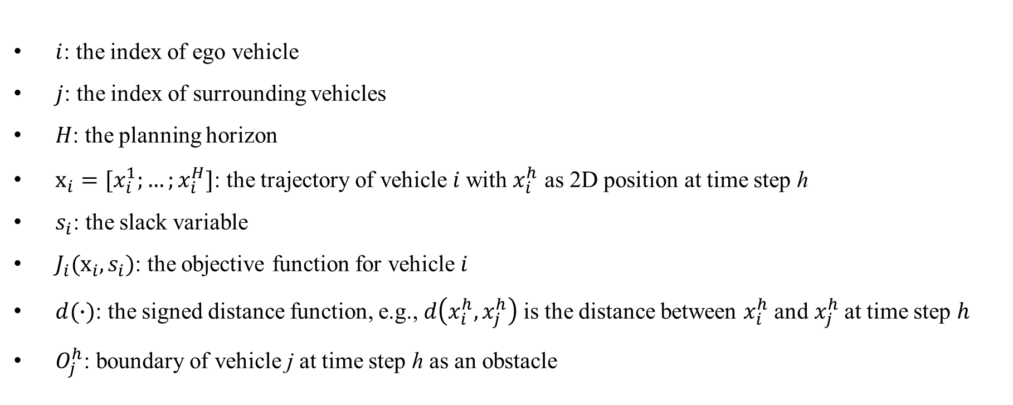
CFS-DMPC
Notation:
$i$: the index of ego vehicle
$j$: the index of surrounding vehicles
$H$: the planning horizon
$x_{i}=[x_{i}^{1};…;x_{i}^{H}]$: the trajectory of vehicle $i$with $x_{i}^{h}$ as 2D position at time step h
$s_{i}$: the slack variable
${J_{i}(x_{i}, s}_{i})$: the objective function for vehicle $i$
$d(∙)$: the signed distance function, e.g., $d\left(x_{i}^{h},x_{j}^{h}\right)$is the distance between $x_{i}^{h}$and$x_{j}^{h}$ at time step $h$
$O_{j}^{h}$: boundary of vehicle j at time step h as an obstacle
C. Liu, C. Lin, and M. Tomizuka, "The convex feasible set algorithm for real time optimization in motion planning", in SIAM Journal on Control and Optimization, vol. 56, no. 4, pp. 2712-2733, Jul. 2018

Slide 13

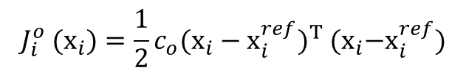
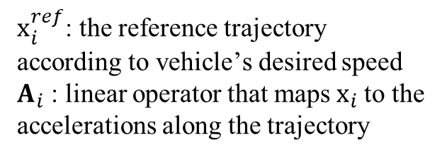
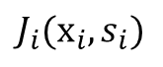

CFS-DMPC
Cost function:
${J_{i}(x_{i}, s}_{i})$
$x_{i}^{ref}$: the reference trajectory according to vehicle’s desired speed
$A_{i}$ : linear operator that maps $x_{i}$to the accelerations along the trajectory
Total cost
Cost of trajectory deviation
Cost of trajectory acceleration
Cost of magnitude of slack variable
$${J_{i}^{o} (x}_{i})={\frac{1}{2}c}_{o}{(x_{i}−x_{i}^{ref})}^{T}{ (x}_{i}−x_{i}^{ref})$$
$${J_{i}^{a} (x}_{i})={\frac{1}{2}c}_{a}{(A_{i}x_{i})}^{T}{ (A_{i}x}_{i})$$
$${J_{i}^{s} (s}_{i})=c_{s}{s_{i}}^{T}s_{i}$$

Slide 14
CFS-DMPC
Constraints:
Safety constraint: force each vehicle pair (i, j) to maintain a safety distance at every time step
Vehicle i
Vehicle j
Vehicle k
Initial position: make the planned trajectories to start as close to the vehicle’ current position as possible

Slide 15

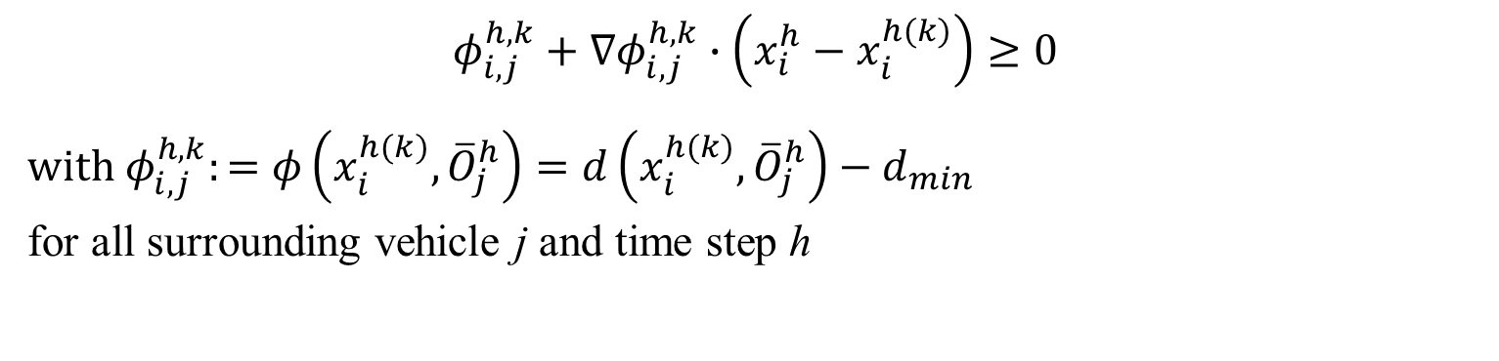

CFS-DMPC
Safety constraint:
Assume vehicles are connected, i.e., are able to share low-bandwidth information, this is constant
$$φ\left(x_{i}^{h},{\overline{x}}_{j}^{h}\right)=d\left(x_{i}^{h},{\overline{x}}_{j}^{h}\right)−d_{min}≥0$$
$$with d_{min} \text{as} \text{the} \text{safety} \text{margin}$$
Use CFS to convexify the safety constraint
$${\overline{O}}_{j}^{h}$$
$$φ_{i, j}^{h, k}+∇φ_{i, j}^{h, k}∙\left(x_{i}^{h}−x_{i}^{h(k)}\right)≥0$$
$$with φ_{i, j}^{h, k}:=φ\left(x_{i}^{h(k)},{\overline{O}}_{j}^{h}\right)=d\left(x_{i}^{h(k)},{\overline{O}}_{j}^{h}\right)−d_{min}$$
for all surrounding vehicle j and time step h

Slide 16

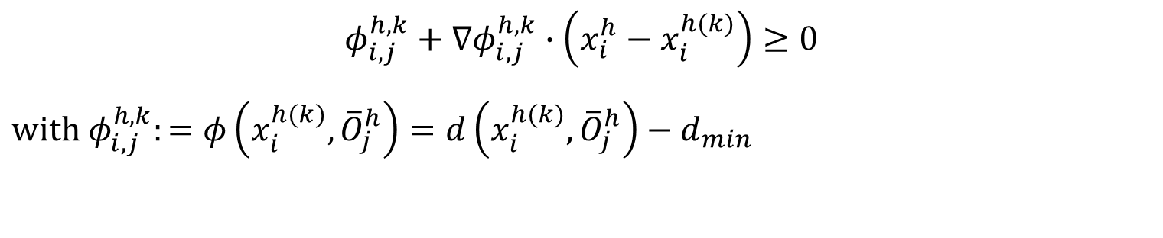



CFS-DMPC
Safety constraint:
$$φ_{i, j}^{h, k}+∇φ_{i, j}^{h, k}∙\left(x_{i}^{h}−x_{i}^{h(k)}\right)≥0$$
$$with φ_{i, j}^{h, k}:=φ\left(x_{i}^{h(k)},{\overline{O}}_{j}^{h}\right)=d\left(x_{i}^{h(k)},{\overline{O}}_{j}^{h}\right)−d_{min}$$
$${\overline{O}}_{j}^{h}$$
Feasible set
$$x_{i}^{h(k)}$$
with $d_{min}=0$
with $d_{min}=0$

Slide 17
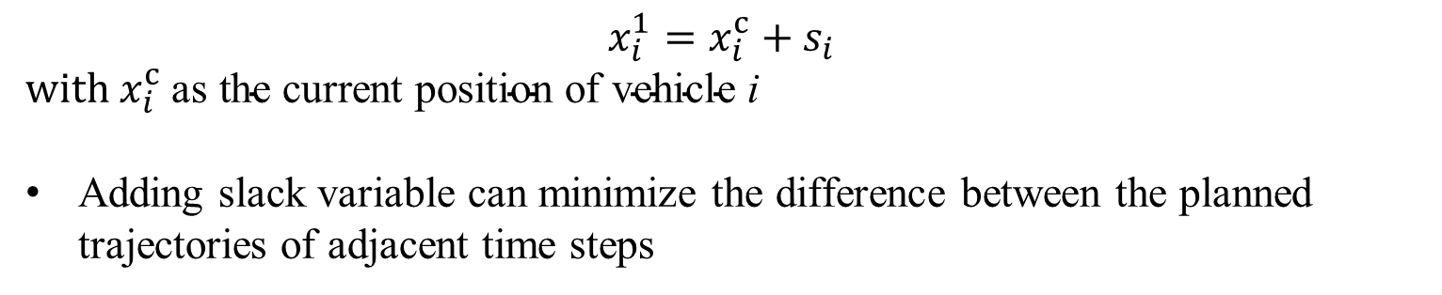
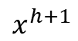
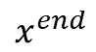
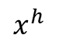
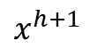
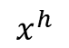
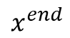
CFS-DMPC
Initial position:
$$x_{i}^{1}=x_{i}^{c}+s_{i}$$
$$with x_{i}^{c} \text{as} \text{the} \text{current} \text{position} \text{of} \text{vehicle} \text{i}$$
Adding slack variable can minimize the difference between the planned trajectories of adjacent time steps
$$x^{h}$$
$$x^{h+1}$$
$$x^{end}$$
$$x^{h}$$
$$x^{h+1}$$
$$x^{end}$$
Without slack variable
With slack variable
J. Chen, C. Liu, and M. Tomizuka, “Foad: Fast optimization-based autonomous driving motion planner,” in 2018 Annual American Control
Conference (ACC). IEEE, 2018, pp. 4725–4732.

Slide 18
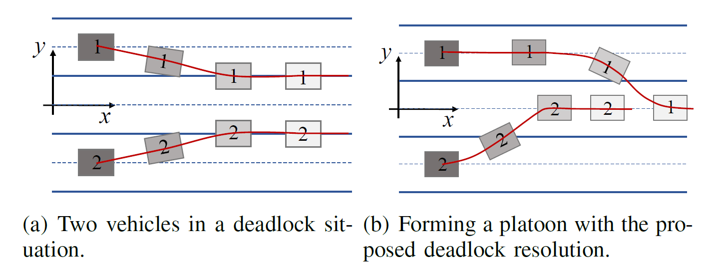
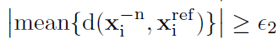
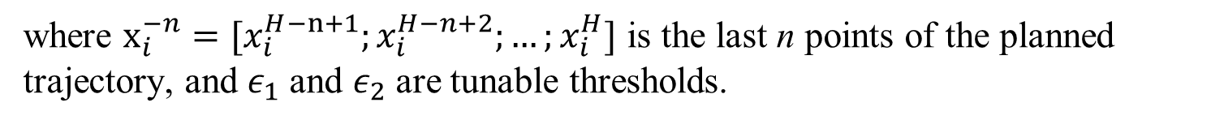
CFS-DMPC
Deadlock resolution:
Criteria to change desired speed:
where $x_{i}^{−n}=[x_{i}^{H−n+1};x_{i}^{H−n+2};…;x_{i}^{H}]$ is the last n points of the planned trajectory, and $ε_{1}$and $ε_{2}$are tunable thresholds.

Slide 19
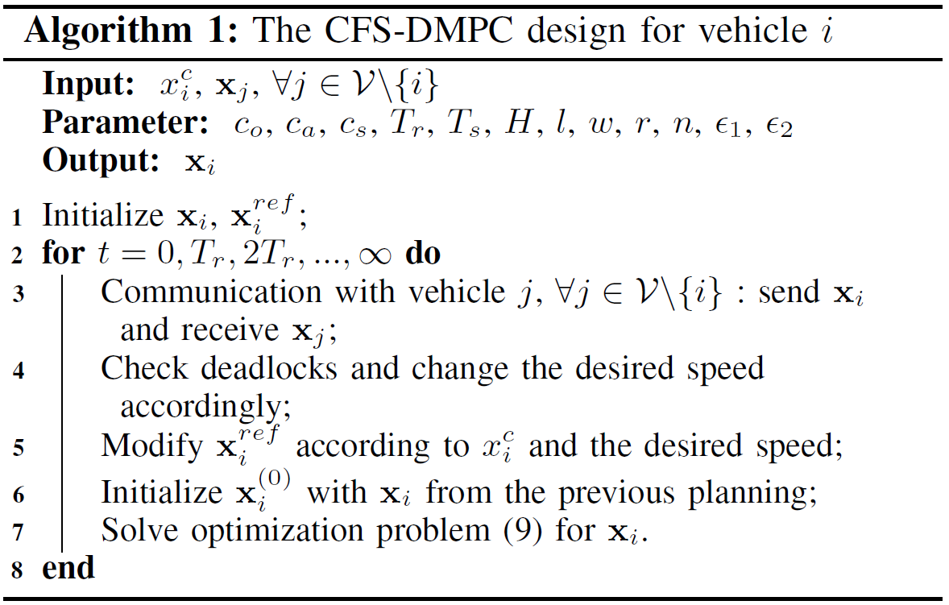
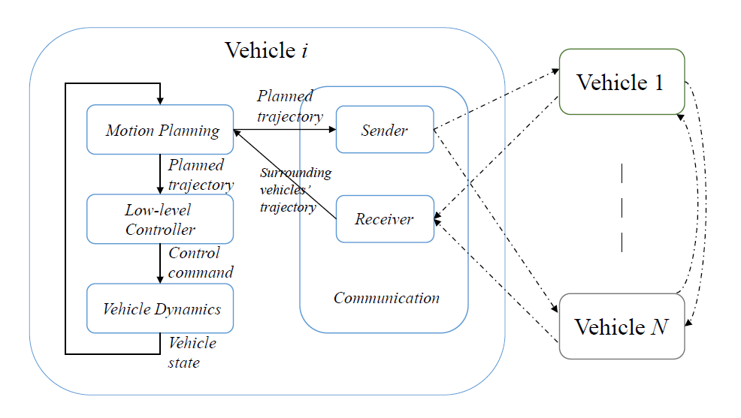
CFS-DMPC
Algorithm and system architecture:

Slide 20
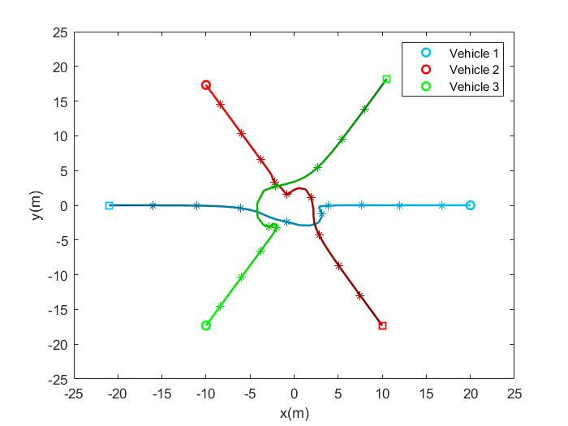
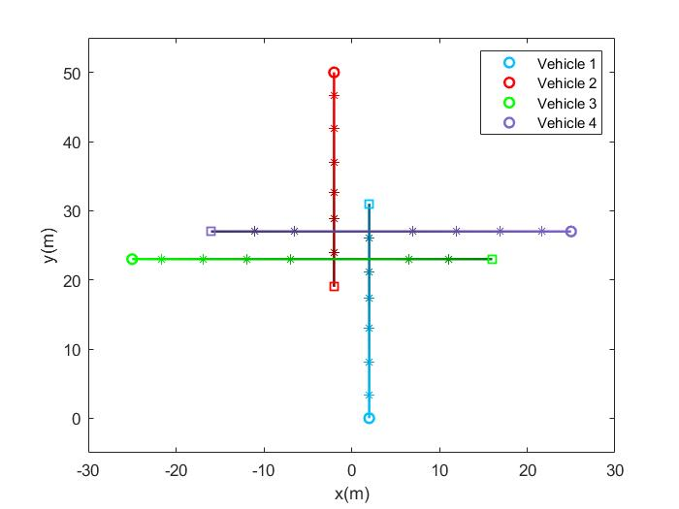
CFS-DMPC
Simulation (without tracking control):
Unstructured env.
(point-to-point transition on a circle)
Intersection

Slide 21
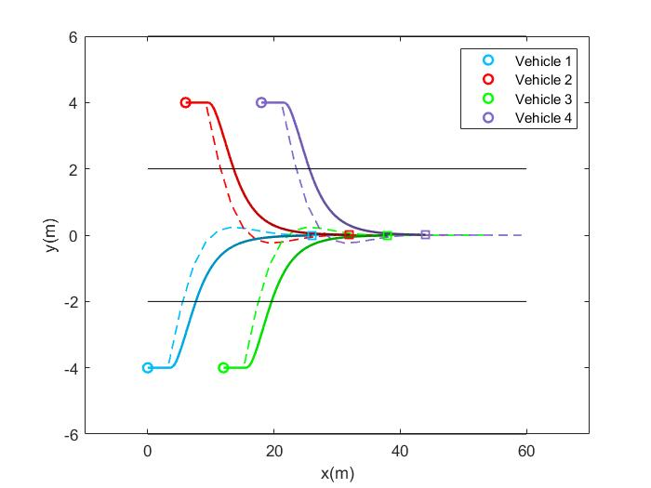
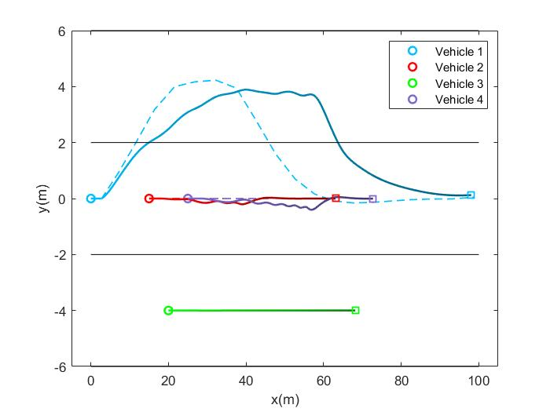
CFS-DMPC
Simulation (with tracking control):
Platoon formation
Overtaking

Slide 22
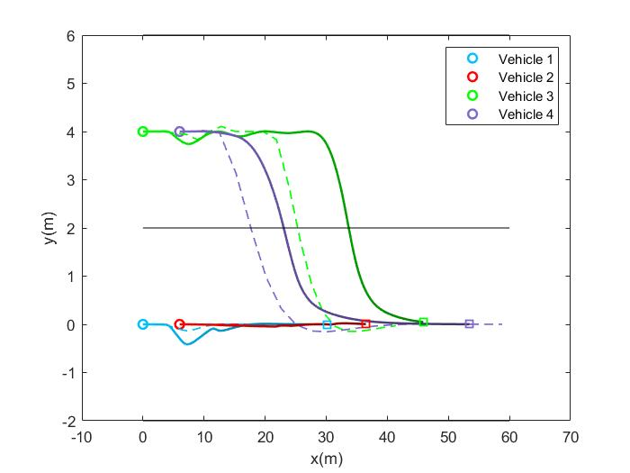
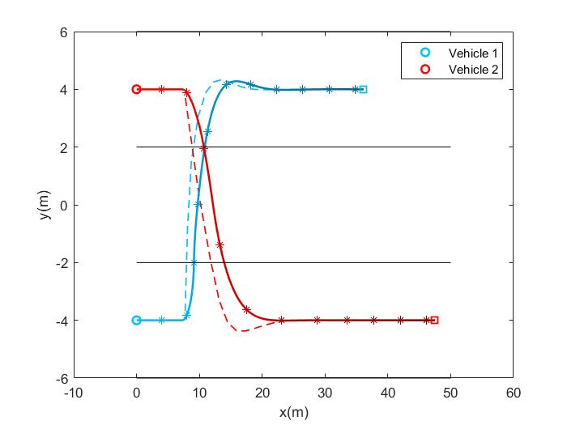
CFS-DMPC
Simulation (with tracking control):
Merging
Crossing

Slide 23
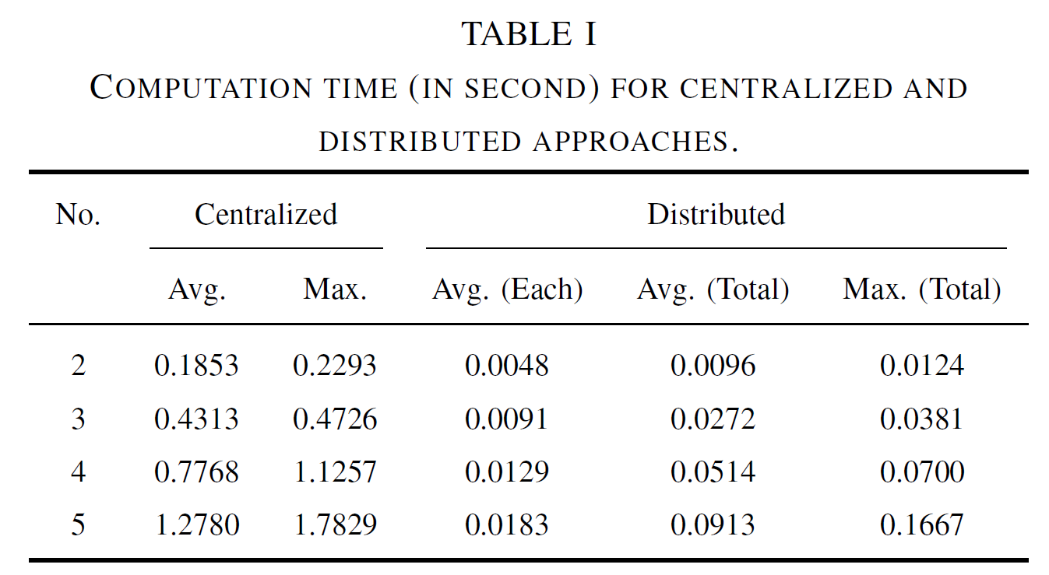
CFS-DMPC
Comparison on efficiency:
J. Huang and C. Liu, “Multi-car convex feasible set algorithm in trajectory planning,” in Dynamic Systems and Control Conference.
American Society of Mechanical Engineers, 2020.

Slide 24
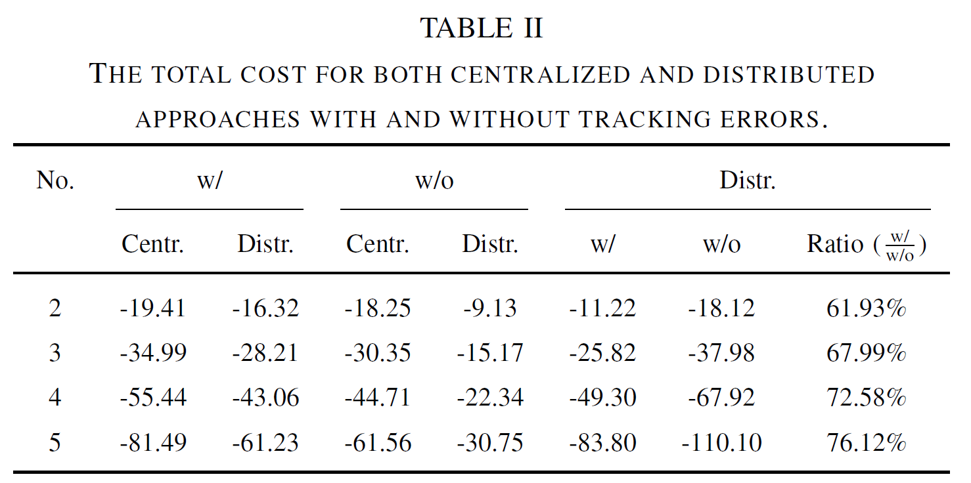
CFS-DMPC
Comparison on optimality:
Distributed MPC is more time-efficient but sacrifices optimality
Robustness to tracking error, which causes lost of optimality
J. Huang and C. Liu, “Multi-car convex feasible set algorithm in trajectory planning,” in Dynamic Systems and Control Conference American Society of Mechanical Engineers, 2020.

Slide 25
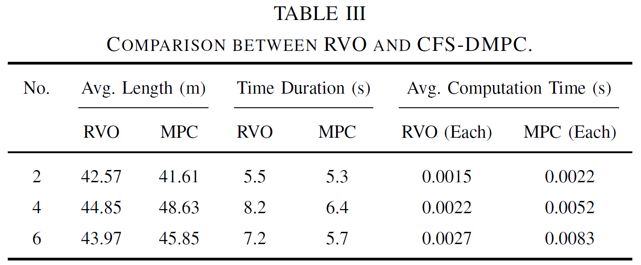
CFS-DMPC
Comparison with RVO in unstructured env.:
+: more time optimal
-: longer computation time
J. Van den Berg, M. Lin, and D. Manocha, “Reciprocal velocity obstacles for real-time multi-agent navigation,” in 2008 IEEE International Conference on Robotics and Automation. IEEE, 2008, pp. 1928–1935.

Slide 26
Outline
Motivation
Contributions
Introduction to Convex Feasible Set Algorithm
Convex Feasible Set Based Distributed Model Predictive Control
Conclusions and Future Work

Slide 27
Conclusions and Future Work
Conclusions
Implemented CFS in distributed model predictive control for multi-vehicle coordination
Proposed a deadlock resolution by changing a vehicle’s desired speed
Simulation results showed the efficiency and robustness
Future work
Conduct real-work experiment
Analyze theoretical stability and robustness

Slide 28
Thank you! Q&A

